Slide 1
Hypothesis formation
CT127-3-2& Programming for Data Analysis

Slide 2
Topic Learning Outcomes
At the end of this topic, you should be able to:
1. Understand what is hypothesis
2. Understand the types of hypothesis
3. Understand hypothesis formation

Slide 3
Contents & Structure
What is Hypothesis?
Hypothesis Formation
Types of Hypothesis

Slide 4
Recap From Last Lesson
What is Data Analytics?
Difference between Data Analytics and Data Science?
Types of Data Analysis

Slide 5
HYPOTHESIS
A hypothesis is a steppingstone to proving a theory.
A hypothesis is a statement that can be tested by scientific research. If you want to test a relationship between two or more variables, you need to write hypotheses before you start your experiment or data collection.
Example: Hypothesis
Daily apple consumption leads to fewer doctor’s visits.
Daily exposure to the sun leads to increased levels of happiness.
A hypothesis states your predictions about what your research will find.
It is a tentative answer to your research question that has not yet been tested.
For some research projects, you might have to write several hypotheses that address different aspects of your research question.

Slide 6
Parts of a Hypothesis: Independent and Dependent Variables
Hypotheses propose a relationship between two or more types of variables.
An independent variable is something the researcher changes or controls.
A dependent variable is something the researcher observes and measures.
An independent variable stands on its own and is not changed by other variables
The dependent variable depends on other factors
Example: Hypothesis
Daily apple consumption leads to fewer doctor’s visits.
Daily exposure to the sun leads to increased levels of happiness.

Slide 7
Developing a hypothesis
Step 1. Ask a question
Writing a hypothesis begins with a research question that you want to answer. The question should be focused, specific, and researchable within the constraints of your project.
Step 2. Do some preliminary research
Your initial answer to the question should be based on what is already known about the topic.
This can also help you identify which variables you will study and what you think the relationships are between them
Step 3. Formulate your hypothesis
Now you should have some idea of what you expect to find. Write your initial answer to the question in a clear, concise sentence.

Slide 8
4. Refine your hypothesis
-hypothesis is specific and testable.
-the hypothesis should contain:
The relevant variables
The specific group being studied
The predicted outcome of the experiment or analysis
5. Phrase your hypothesis
-hypothesis have to rephrase clearly by indicating independent and dependent variables.
6. Write a null hypothesis
-If your research involves statistical hypothesis testing, you will also have to write a null hypothesis.
-The null hypothesis is the default position that there is no association between the variables.
-The null hypothesis is written as H₀, while the alternative hypothesis is H₁ or H_{a}.

Slide 9
Types of Hypotheses
The most common forms of hypotheses are:
Simple Hypothesis
Complex Hypothesis
Null Hypothesis
Alternative Hypothesis
Logical Hypothesis
Empirical Hypothesis
Statistical Hypothesis

Slide 10
Simple Hypothesis
A simple hypothesis predicts the relationship between two variables:
the independent variable and the dependent variable.
Example:
Drinking sugary drinks daily leads to being overweight.
Smoking cigarettes daily leads to lung cancer.
Assignment Example:
Customers with higher number of loans tend to have good credit score.

Slide 11
Complex Hypothesis
A complex hypothesis describes a relationship between variables.
It’s a relationship between two or more independent variables and two or more dependent variables.
Example:
Adults who 1) drink sugary beverages on a daily basis and 2) have a family history of health issues
are more likely to 1) become overweight and 2) develop diabetes or other health issues.
Assignment Example:
Customers with lower annual income with high amount of outstanding debts and inconsistent payment behaviour have poor credit score.

Slide 12
Null Hypothesis
A null hypothesis, denoted by H₀, proposes that two factors or groups are unrelated and that there is no difference between certain characteristics of a population or process.
You must test the likelihood of the null hypothesis, in tandem with an alternative hypothesis, in order to disprove or discredit it.
Example:
There is no significant change in a person’s health during the times when they drink green tea only or root beer only.
Assignment Example:
Interest rate on credit card does not affect the credit score of customers.

Slide 13
Alternative Hypothesis
An alternative hypothesis, denoted by H₁ or H_{A} , is a claim that is contradictory to the null hypothesis. Researchers will pair the alternative hypothesis with the null hypothesis in order to prove that there is no relation.
Example:
A person’s health improves during the times when they drink green tea only, as opposed to root beer only.
Assignment Example:
Interest rate on credit card does affect the credit score of customer

Slide 14
Logical Hypothesis
- A logical hypothesis is a proposed explanation using limited evidence
- There is currently no evidence to support these hypotheses.
Example:
Cacti experience more successful growth rates than tulips on Mars.
Assignment Example:
Customers with higher monthly salary have better credit score than those who have lower monthly salary.

Slide 15
Statistical Hypothesis
-Statistical hypothesis is an examination of a portion of a population or statistical model.
Example:
50% of Savannah's population lives beyond the age of 70.
45% of the poor in the U.S. are illiterate.
Assignment Example:
40% of customers with annual income of $100,000 - $150,000 and delay from due date of less than 1 week have better credit score than those with annual income of $50,000 - $100,000 and delay due date that more than 1 week.

Slide 16
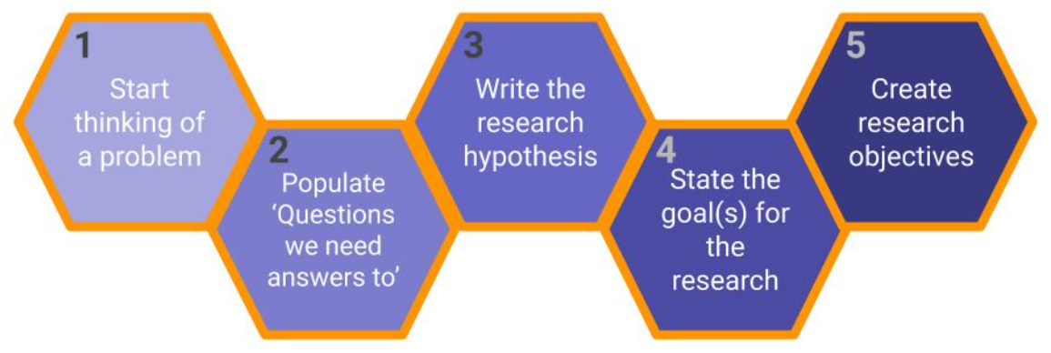

Slide 17
Examples of Hypothesis and OBJECTIVES
Hypothesis:
Working from home increases employee productivity
Objectives:
- To find the impact of employee productivity based on the infrastructure availability at home
- To find the impact of employee productivity based on the circumstances availability at campus
- To compare the productivity based offline and online mode
Results:
Obj1: Working from home is shown to increase employee productivity by 40%. Study conducted in companies A, B, C, D; Hypothesis accepted.
Obj2 : Working from home is shown to decrease employee productivity by 18%. Study conducted in companies E, F, G, H; Hypothesis rejected.
Obj3: Working from home affects employee productivity differently under different circumstances, although the results are seemingly positive side.

Slide 18
Review Questions
-What is Hypothesis?
-What is the variables involved in hypothesis?
-How to form a hypothesis?
-what are the different ways to create a hypothesis?

Slide 19
Summary / Recap of Main Points
Hypothesis
Dependant variables and independent variables
Types of hypothesis formation

Slide 20
What To Expect Next Week
In Class
Preparation for Class
Data Analysis Techniques
Data Analytics Case Studies

